Slide 1

Neural Networks
Deep Learning
and friends...

Slide 2
Agenda
AI – Where does DL fit?
How is it different from “Classical” Programming
Path from Design to Production
What is a Neuron
  With live examples
Neuronal Network: TensorFlow playground
Machine Learning
  Layers
  See it at work on TF Playground
Training a Model
  Building the Network
Car Insurance Demo
Character Recognition
  With OpenCV
Notes:
Start Jupyter Notebook from
~/repos/raspberry-coffee/JupyterNotebooks/deep.learning.crash.course
$ jupyter notebook
Then see http://localhost:8888/tree in a browser
Start the node server from ~repos/raspberry-coffee/JupyterNotebooks/deep.learning.crash.course/insurance.demo/tfjs
$ node server.js

Slide 3
The Tools
Java
Python
Jupyter Notebooks
  For Python
  For Java
TensorFlow
Keras
OpenCV
Jupyter Notebooks

Slide 4
We will
See what ML/DL is, why it is useful, and what challenges it might face
See what a neuron is, where and how it fits
See what a Neuron Network is and how to build one
See how to use a Neuron Network to train a model
Use a simple example, train a model, and use it
Take a more complex (aka real) example, end to end

Slide 5
Machine Learning

Slide 6
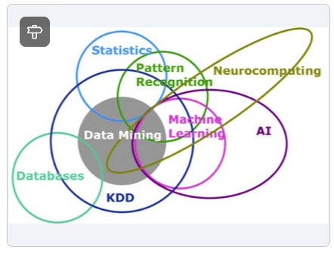
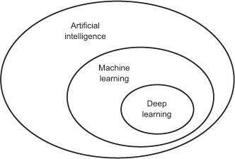
Machine Learning
(KDD: Knowledge Discovery in Databases)

Slide 7
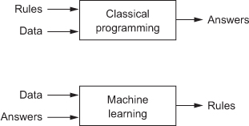
How is that different?
For the learning phase – aka model training – you need a lot of data (the more the better),
separated in two groups:
Input data, parameters of the equation (like age, speed, mileage)
Known output, result (risk level)
The learning phase is the process that tries to find the way to reach the expected result
with the input parameters for all the data of the training data set.
Notes:
Talk here about the first example we are going to use, the Insurance one.

Slide 8
Where it fits
It is all about the MODEL
The MODEL is the entity that will eventually apply the rules found during the Training
  Training the MODEL is equivalent to finding the Rules to apply to future input data to predict the output
Once trained, the model is deployed to production
  Real world and real time data can be sent to the MODEL to get its Predictions
A deployed MODEL can be re-trained and re-deployed to production

Slide 9
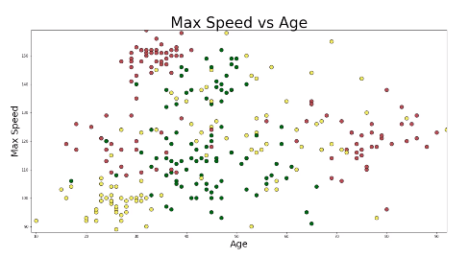
Our first example
Let’s say you are an insurance company, and you want to be able to predict the risk associated with a potential customer, based on
  His age
  The maximum speed of his car
  The mileage he drives per year
We do have existing data, from some insurance company database
Notes:
Ok, this is not realistic, but this is a tutorial!!!

Slide 10
Apply a predefined rule
red = 0
green = 1
yellow = 2
def evaluate_risk(age, speed, miles_per_year):
if age < 25:
if speed > 140:
return red # Crazy young guy, car too fast
else:
return yellow # Car is slow enough for medium risk
if age > 75:
return red # Get off the road, old man!
if miles_per_year > 30:
return red # You drive too much
if miles_per_year > 20:
return yellow
return green # otherwise, low risk
Notebook here: http://localhost:8888/notebooks/NeuralNetworks.ipynb
Notes:
See the Java notebook at http://localhost:8888/notebooks/NeuralNetworks.ipynb
Use (60, 30, 100),
(40, 10, 100), ...

Slide 11
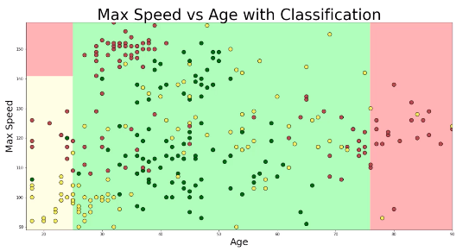
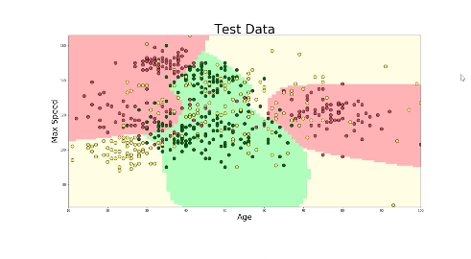
What we have vs what we want
This would produce something like this:
As opposed to what we would expect:

Slide 12

Not good, obviously!
We need another way to tackle that.
Let’s try to teach the machine ...

Slide 13
Neurons
(aka Artificial Neurons)

Slide 14

What’s a Neuron
First of all, this is not new!
It looks a lot like a mathematical function, because this is what it is
A Neuron has a single numerical output (usually called y)
It can have several inputs (also called dimensions), usually named X_{i}, associated with a weight W_{i}.
It also has a constant, called the bias (noted b)
Its formula is
In the next sections, they will be part of the hidden layers

Slide 15
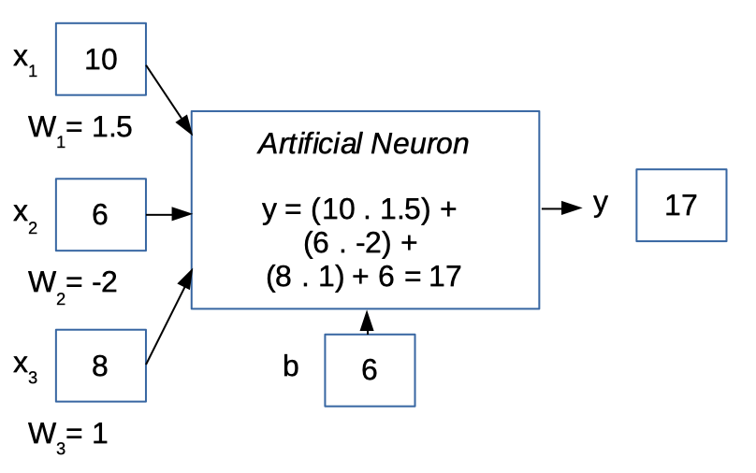
Example
Yes, it is very simple!
Java Notebook
Web page
Notes:
See https://olivierld.github.io/nn/one.neuron.webcomp.html
Java Notebook:
http://localhost:8888/notebooks/NeuralNetworks.ipynb

Slide 16
Neuron Networks

Slide 17
Neural Networks
Introducing TensorFlow Playground
  The different datasets
  See the input nodes
  The hidden layers
    Note: The number of hidden layers is called the depth of the network. This is where the Deep in Deep-Learning comes from.
  The weights (lines thickness)
  The bias (small squares at the bottom left of the neurons)
  The run button
    Notice the loss graph
      Test, training losses
  Learning rate
  Activation
  ...
Note: A Tensor is the vector containing the input data

Slide 18
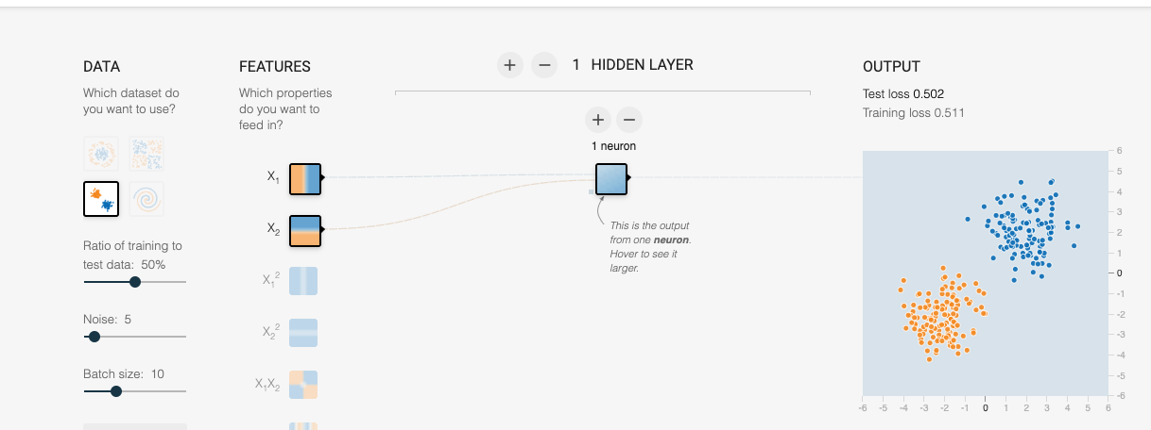
TensorFlow Playground
Here we have 2 input dimensions, x₁ (abscissa) and x₂ (ordinate).
The weight of each dimension is represented by the thickness of the line between the dimension and the neuron(s)
The bias of the neuron is represented by the (very) small little gray square at the bottom left of the neuron(s).
The output will be a single number, ranging from -1 to +1.
The background of the graphic on the right will reflect the prediction, it will be orange if y < 0, and blue if y > 0.
You can change the weights associated with each box (dimensions and neuron(s)), as well as the bias of each neuron.

Slide 19
Activation Functions
An activation function is triggered after weight(s) and bias are applied
It “re-centers” the result (y) of the neuron
  In the previous TF example, the result will be “orange” or “blue”. A value like -1 or +1, 0 or +1 is absolutely good enough
Common activation functions are
  Sigmoid
  TanH
  Step
  ReLU
  SoftMax
See them live here

Slide 20
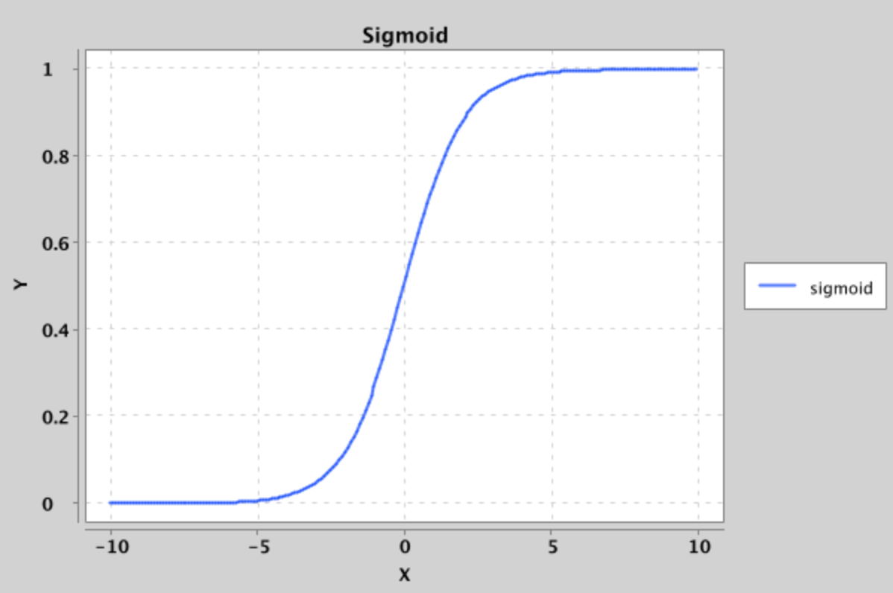
Sigmoid
x → (1 / (1 + e^{-x}))

Slide 21
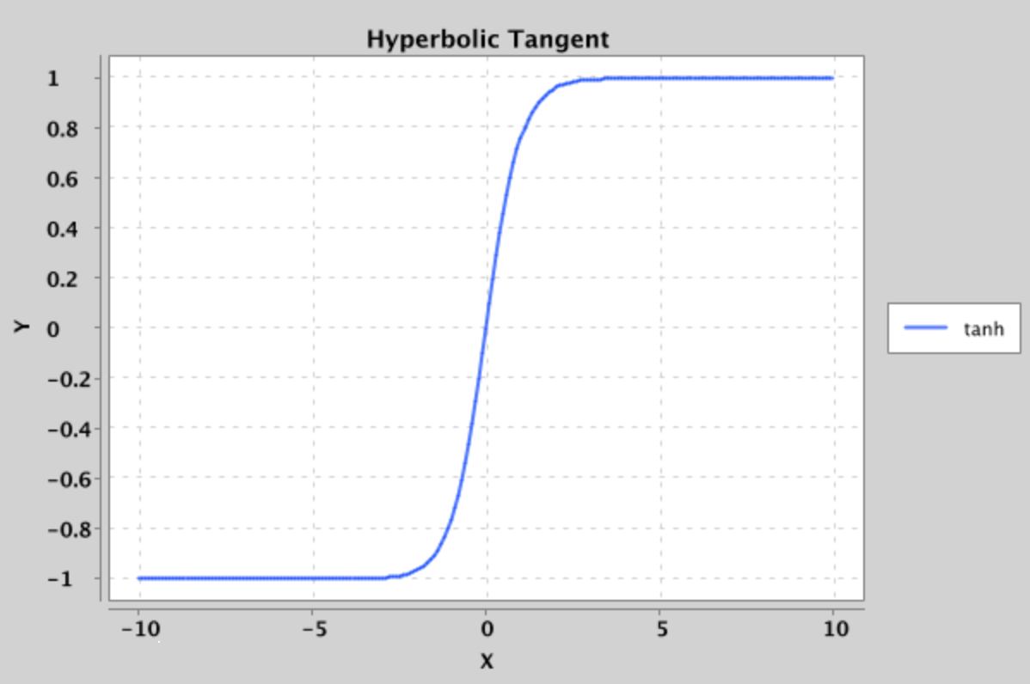
Hyperbolic Tangent
x → (e^{x} – e^{-x}) / (e^{x} + e^{-x})

Slide 22
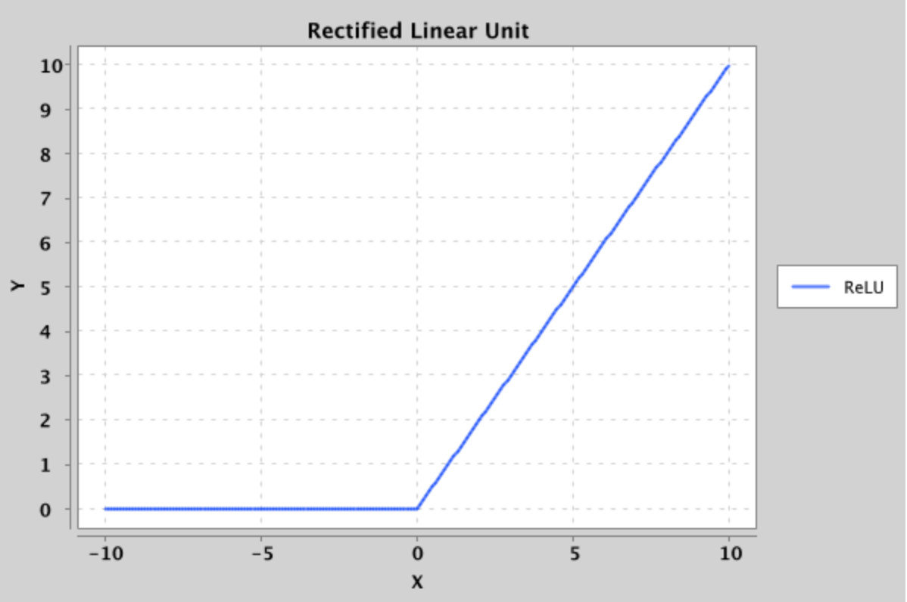
Rectified Linear Unit (ReLU)
x → x < 0 ? 0 : x

Slide 23
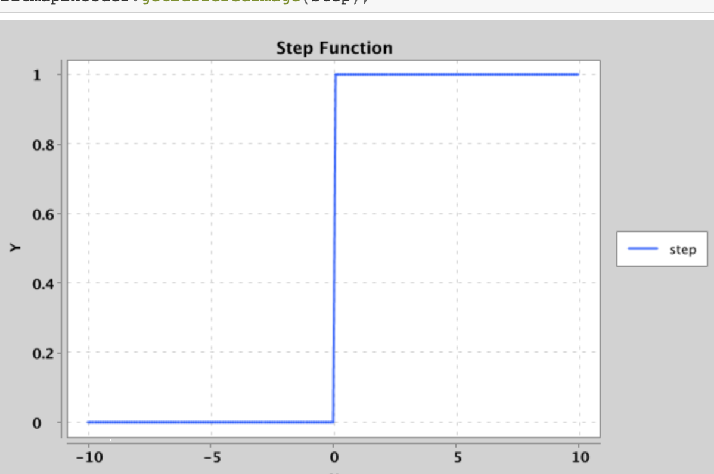
Step
x → x < 0 ? 0 : 1

Slide 24
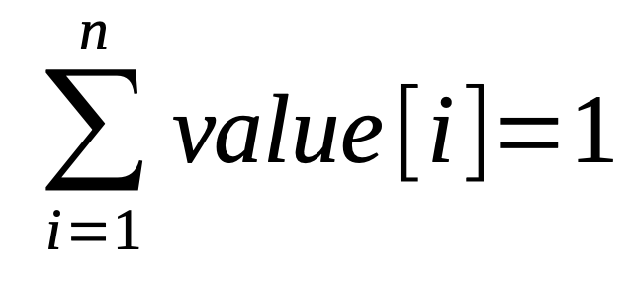
SoftMax
Depends on the number of expected output values, suited for Classification problems
For example, in the car insurance case
We say:
Red = 0
Yellow = 1
Green = 2
A result like [0.01, 0.95, 0.04]
is red=1%, yellow=95%, green=4%

Slide 25
Loss
That is THE thing leading to an accurate model
  The loss is the difference between the reality and what the model comes up with
  Finding the minimal loss is the goal of the training
  The smallest the loss, the best the model
    Obviously!
Loss can be set for
  Training data
  Test data

Slide 26
Demo
TensorFlow Playground
TensorFlow Playground
Notes:
See the TensorFlow Playground Cheat Sheet.

Slide 27
How does the Network learn?

Slide 28
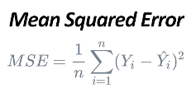
Minimizing the Loss
For each tuning position of the network (weights, bias, for all neurons in all layers)
Compare the calculated result with the expected one
Use Mean Square Error (MSE) to magnify the loss
Plot it against epoch
Find the spot where loss is the smallest
See here

Slide 29
Training a TensorFlow model

Slide 30
Let’s see some code
Car Insurance Demo:
Jupyter notebook, training a model
  Setting up the network requires some… intuition
Convert model to TensorFlowJS
  tensorflowjs_converter --input_format keras ./insurance.h5 ./tfjs
Using the model in “Production” (Web UI)
Notes:
For the Web App:
From ~/repos/raspberry-coffee/JupyterNotebooks/deep.learning.crash.course/insurance.demo/tfjs
Show how to load a model: sublime .
See load_model.html
See index.html
See the lines
let speed = 140;
let age = 60;
let mpy = 10;
const example = tf.tensor([[ speed, age, mpy ]]); // The tensor
const prediction = model.predict(example);
Start node server.js
Then localhost:8080/index.html

Slide 31
Closer to the real world

Slide 32
Hand-written character recognition
Now we’ve seen the bits and pieces, let’s put them at work
We are going to train a model to recognize hand-written digits, in [0..9]
We will use a webcam to “see” a notepad
Take a snapshot, prepare the data returned by the camera
Send them to the model to predict what digit it is
Let’s go

Slide 33
Hand-written character recognition
We need to “see” the user writing on the notepad
Introducing OpenCV

Slide 34

Hand-written character recognition
A word about data preparation
It is like unraveling the data

Slide 35
Hand-written character recognition
The model will be trained with B&W images, 28x28 pixels
This is the mnist data set, that comes with Keras
  MNIST Stands for “Modified National Institute of Standards and Technology”
  See here.

Slide 36
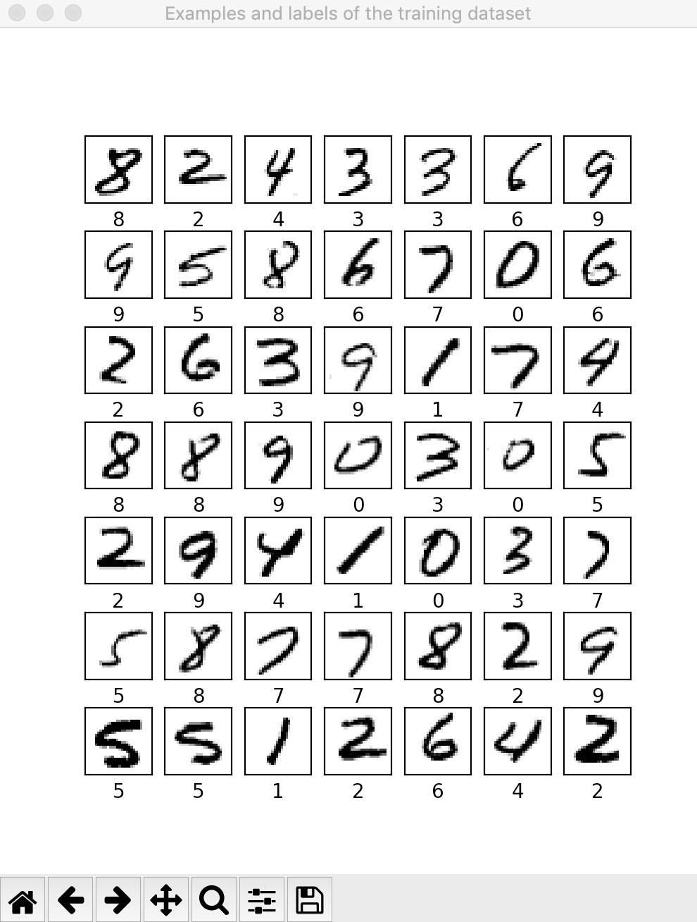
Notes:
See in /Users/olediour/repos/raspberry-coffee/JupyterNotebooks/deep.learning.crash.course/mnist_png

Slide 37
Hand-written character recognition
Using OpenCV, we will
  Take a snapshot
  Select a Region Of Interest (ROI)
  Gray it (no color)
  Blur it to get rid of potential background
  Thresh it (minimize number of colors)
  Resize it as expected by the model

Slide 38
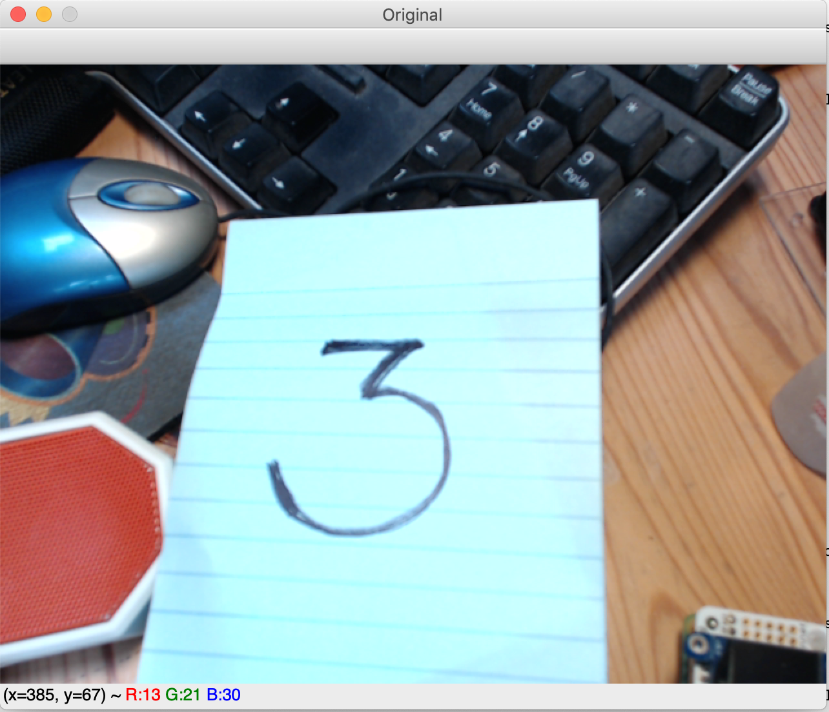
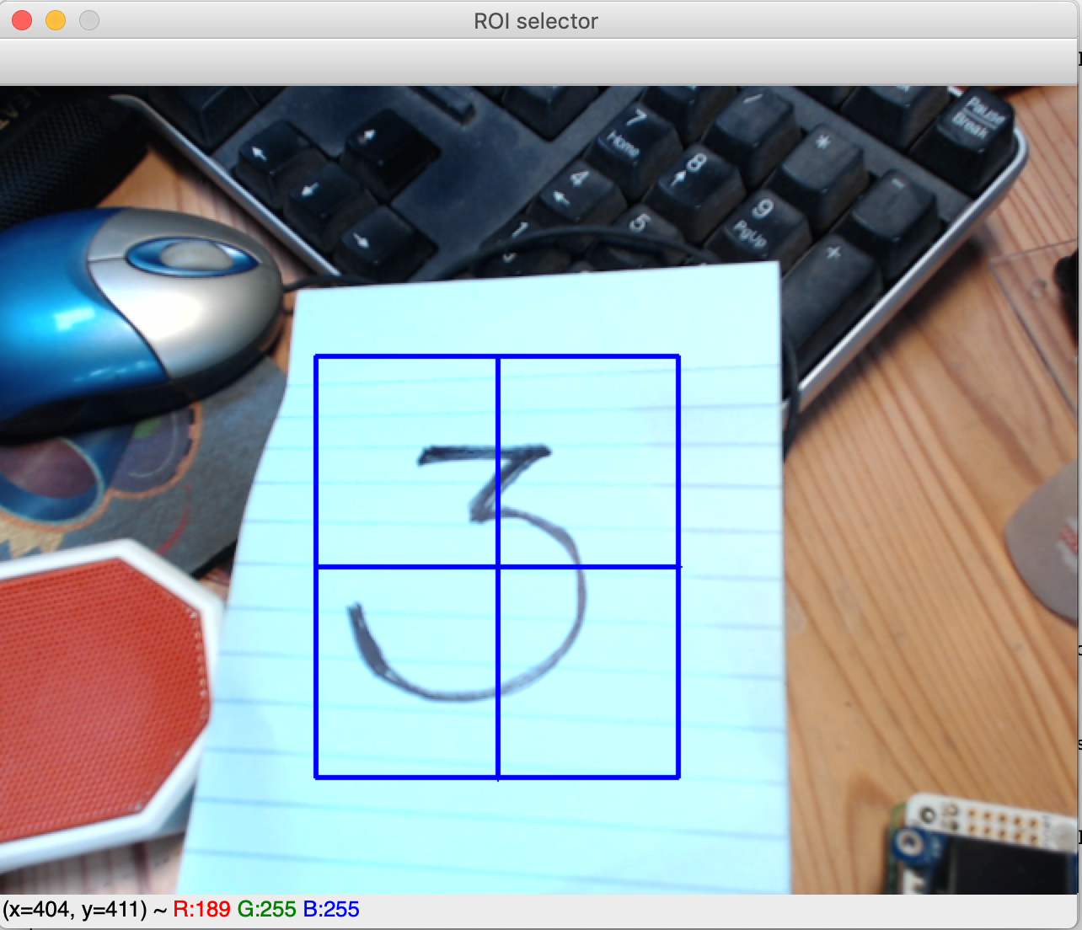
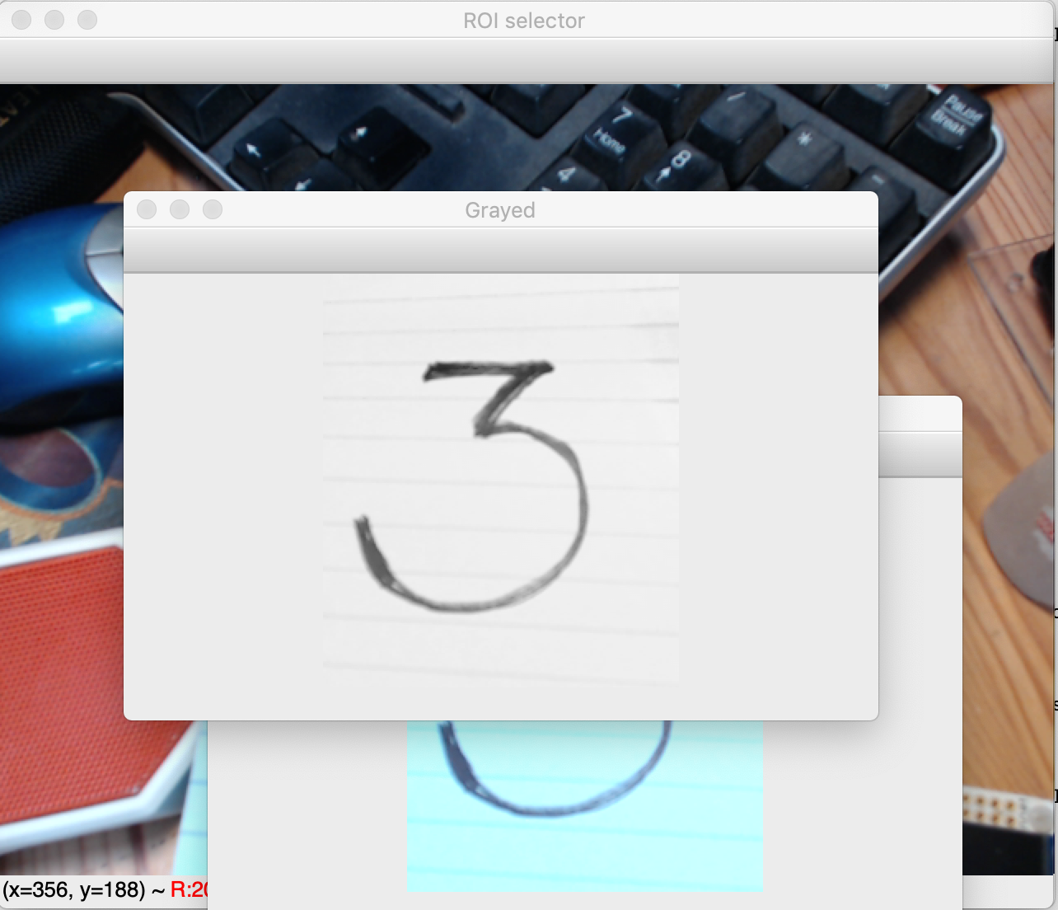

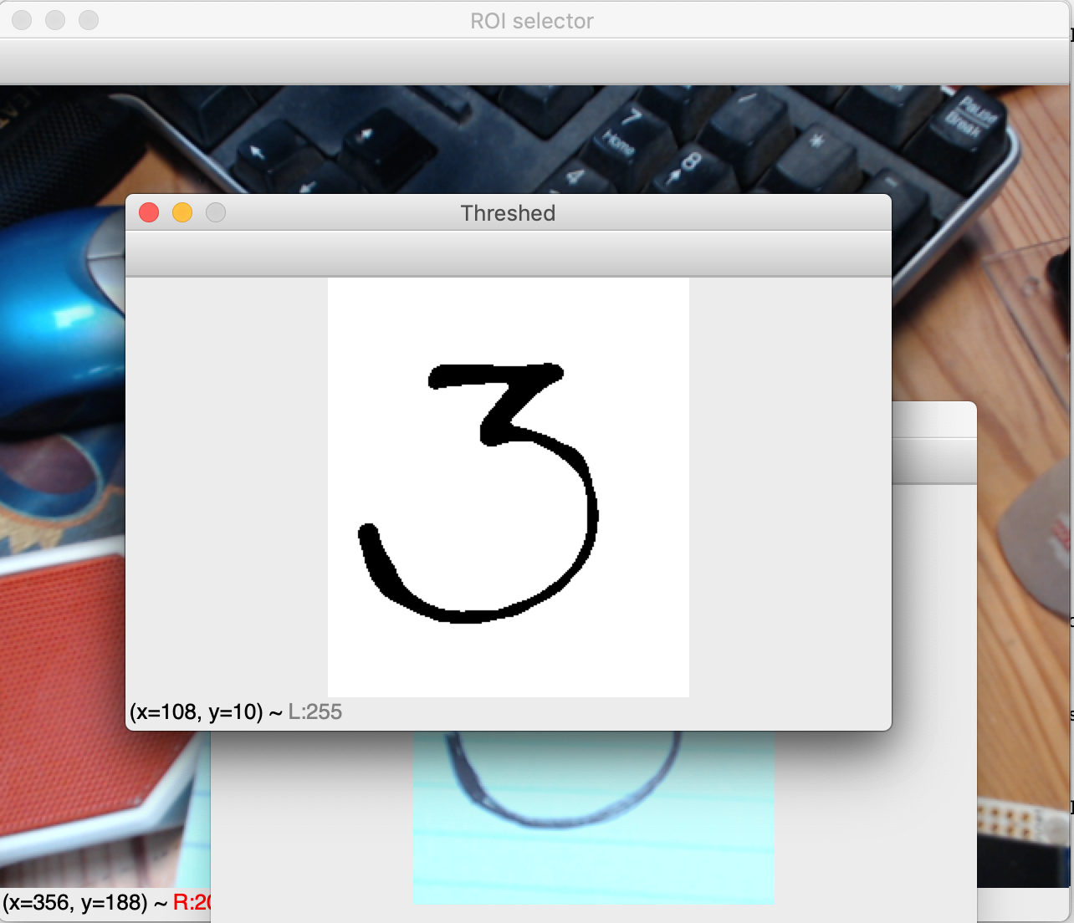
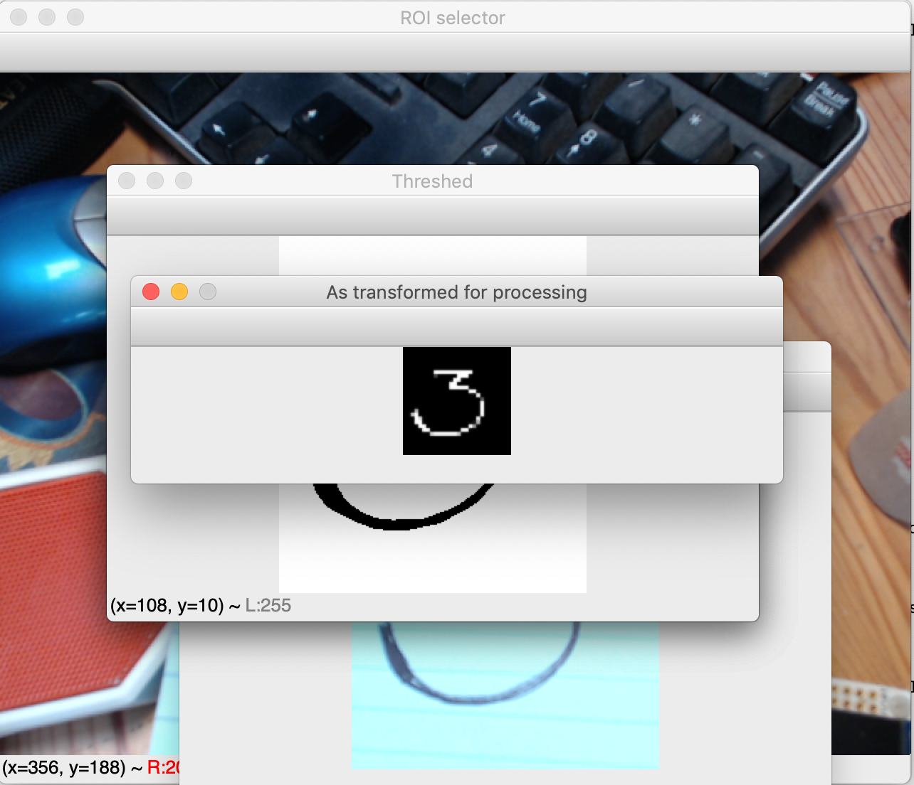
Hand-written character recognition

Slide 39
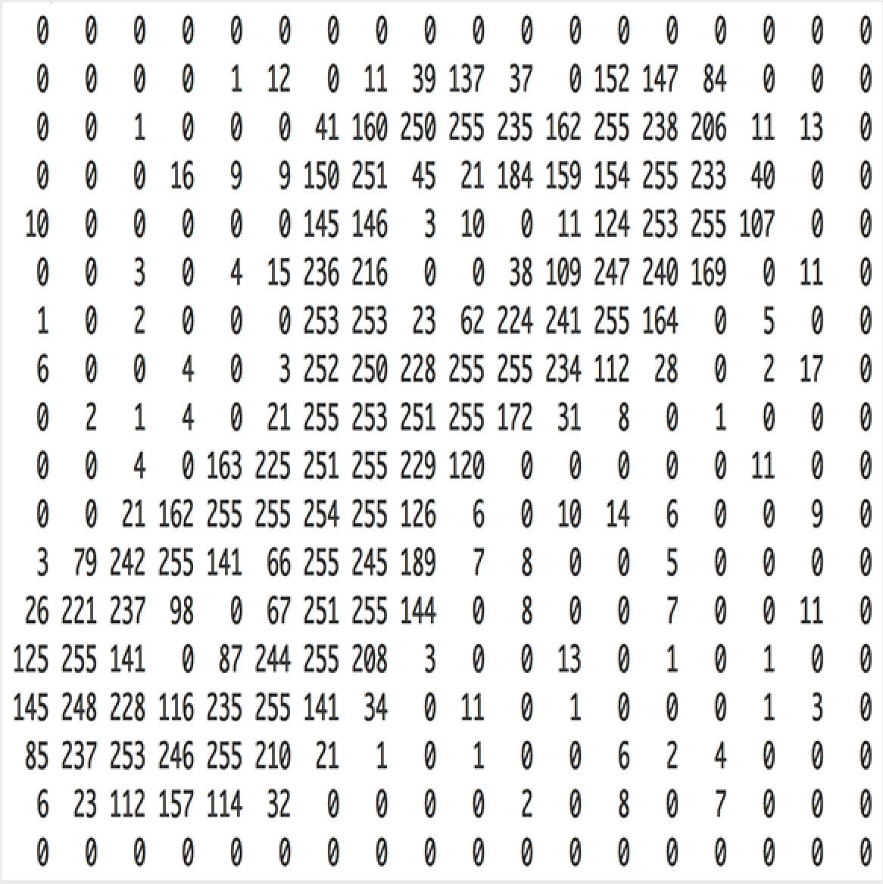
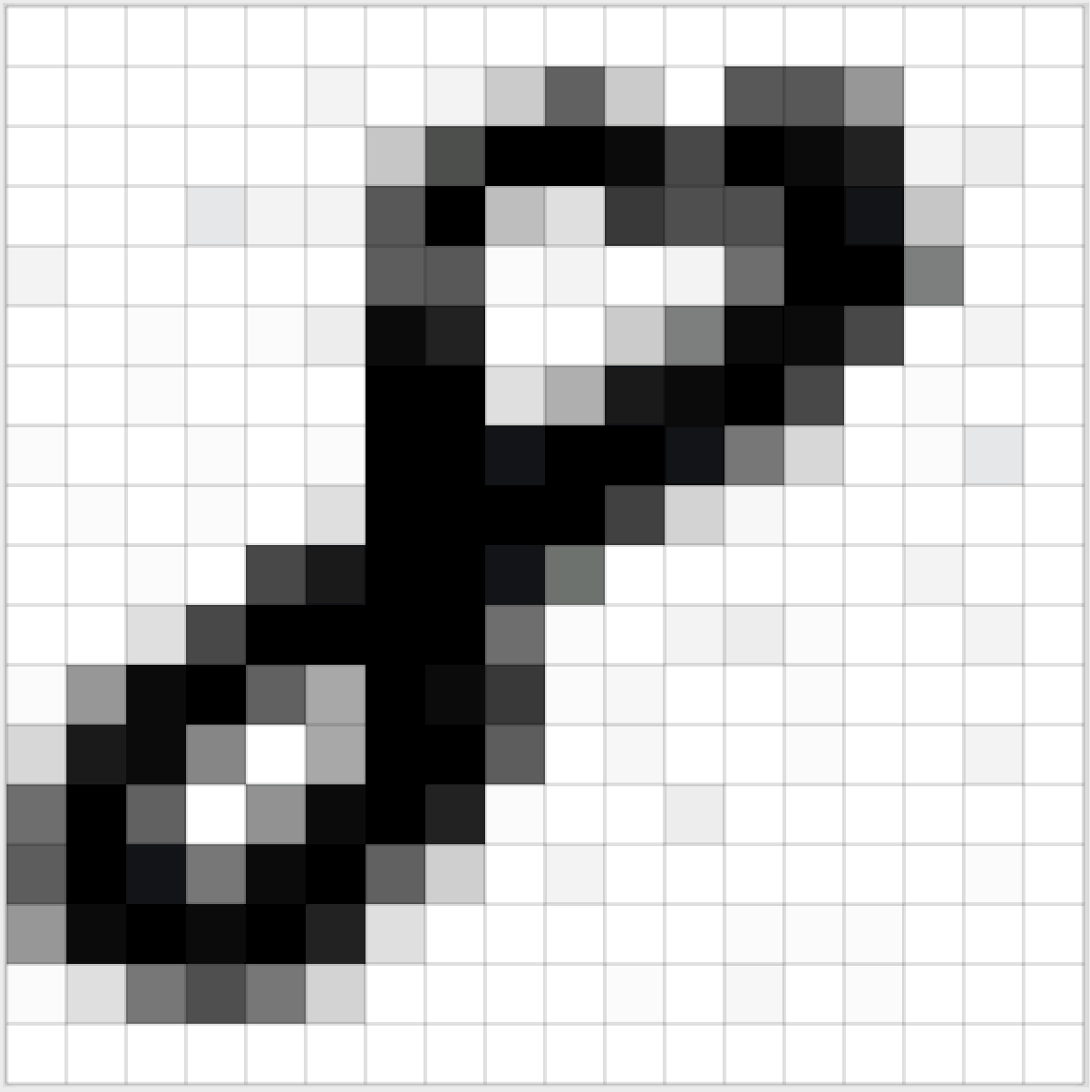
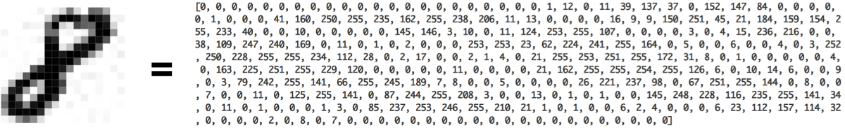
Hand-written character recognition
Data preparation

Slide 40
Hand-Written Digits Demo
Notes:
First on the mnist dataset only:
From folder /repos/raspberry-coffee/JupyterNotebooks/deep.learning.crash.course/digit.demo
Walk through the code, and
run python script
digit.demo/sample.05.1.py ← Training + Using
Then with OpenCV:
- digit.demo/sample.05.2.py with existing images
- digit.demo/sample.05.21.py from the camera

Slide 41
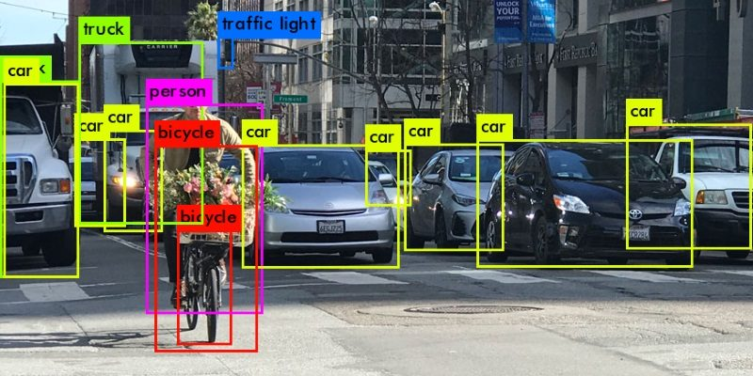
Even closer to the real world: Self driving cars
Detect objects around
  cars, bikes, pedestrians, traffic lights, curbs, etc
Classify them, and make the right decision
  brake, stop, slow down, turn right, etc

Slide 42
Final Bonus.
59 seconds

Slide 43

Recommended reading
Manning’s Deep Learning Crash Course
  by Oliver Zeigermann
Manning’s Grokking Deep Learning
  by Andrew Trask
Manning’s Deep Learning with Python
  by François Chollet
All the material on github.

